Slide 1
Polymerase Chain Reaction
Advanced Cell and Molecular Biology Course
Dr.Shagufta Naz

Slide 2
Polymerase Chain Reaction
History
Introduction
Components
Applications

Slide 3
PCR
Polymerase Chain Reaction is a technique used in molecular biology to amplify a single or a copies of a segment of DNA across several magnitude, generating thousands to million copies of a particular DNA sequence

Slide 4
History
Developed in 1983 by Kary Mullis, PCR is now a common techniques used in clinical and research laboratories for a broad variety of applications
In 1993, Mullis was awarded the Nobel Prize in chemistry for his work on PCR

Slide 5
Purpose
To amplify a lot of double-stranded DNA molecules(fragments) with same size and sequence by enzymatic method and cyclic condition.

Slide 6
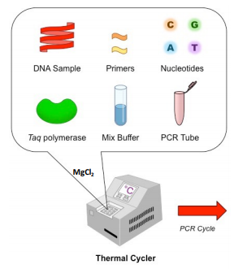
Components of PCR

Slide 7
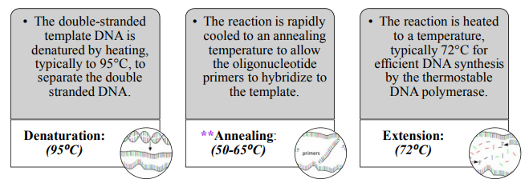
The PCR cycle
PCR proceeds in three distinct steps governed by temperature.

Slide 8
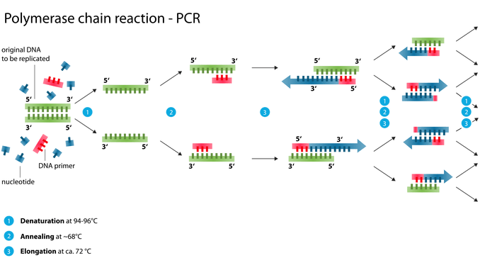
Working

Slide 9
Different types of PCR
Quantitative PCR
Multiplex PCR
Nested-semi nested PCR
Standard PCR
RT-PCR
Hot start PCR
Asymmetric PCR
Touchdown PCR
Colony PCR
COLD PCR
Suicide PCR

Slide 10
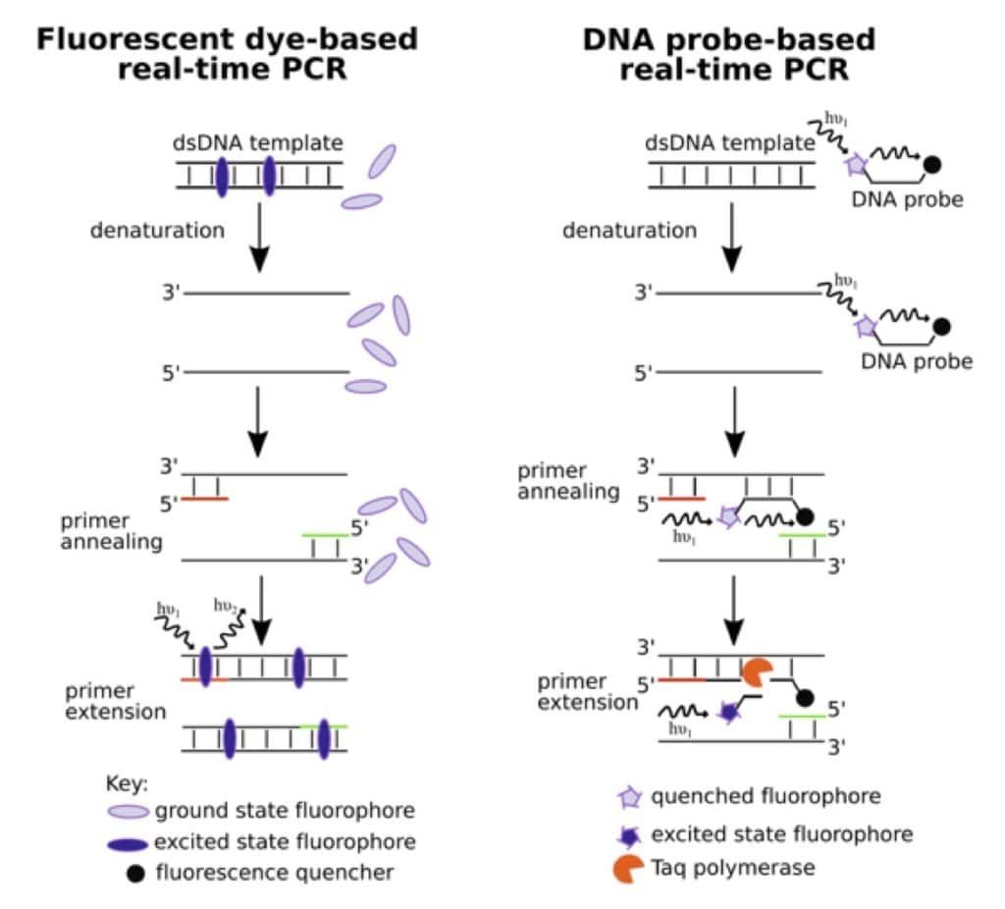
Quantitative PCR
Real-Time PCR
PCR with few
improvements
Types of qPCR
Applications
Fluorescent based and probe based qPCR

Slide 11
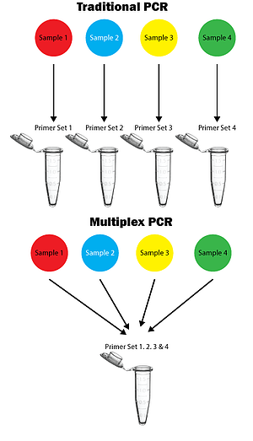
Multiplex PCR
More than one target
sequence can
be amplified
Types of Multiplex PCR
Single template PCR
Multiple Template PCR
Traditional versus Multiplex PCR

Slide 12
Primer design parameters
Primer length
Melting temperature
Specificity
Avoidance of primer-dimer formation
Advantages
Internal controls
Efficiency
Indication of template quality
Indication of template quantity
Application

Slide 13
Nested-semi nested PCR
To reduce contamination in products
Use of two sets of primers
First set is an amplified sequence
Second set is complementary to the first set

Slide 14
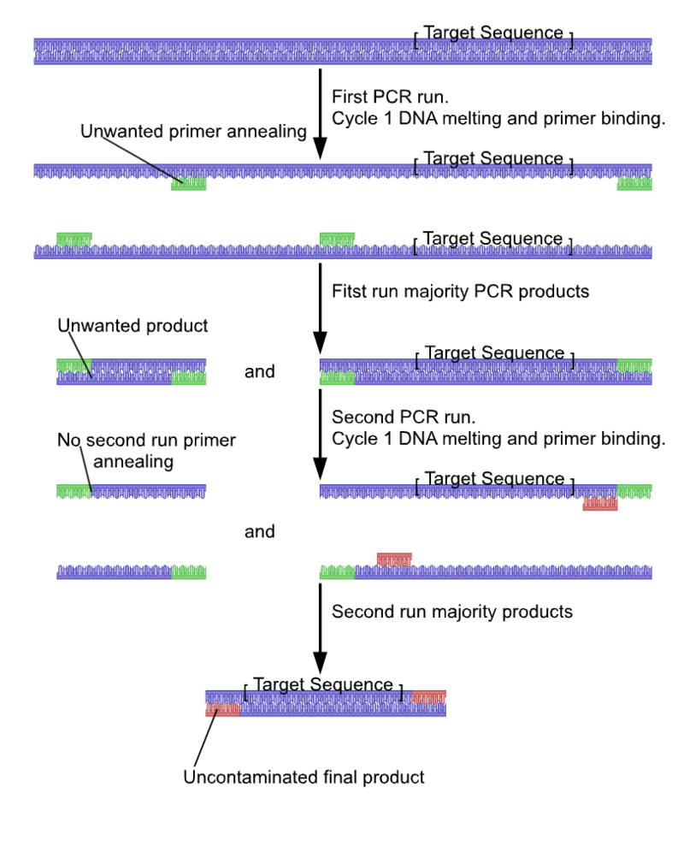
Nested PCR

Slide 15
Standard PCR
Simple efficient and sensitive technique
Use of one pair of primers
Helps in early diagnosis of Brucella
Used to determine no of leukocytes DNA/heamo compounds

Slide 16
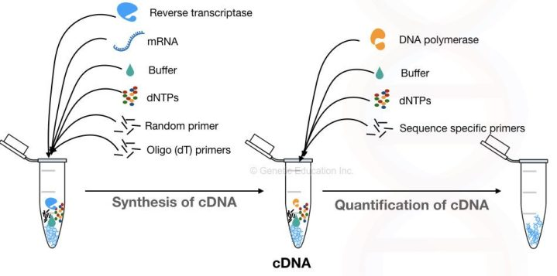
RT-PCR
Measures RNA
expression level
Production
of complementary
DNA
Use of Reverse
transcriptase
Applications
RT-PCR

Slide 17
Hot Start PCR
Allows reaction setup at room temperature
Without non-specific amplification and dimer formation
Method
Physical separation
DNA polymerase inactivation
dNTP modifications

Slide 18
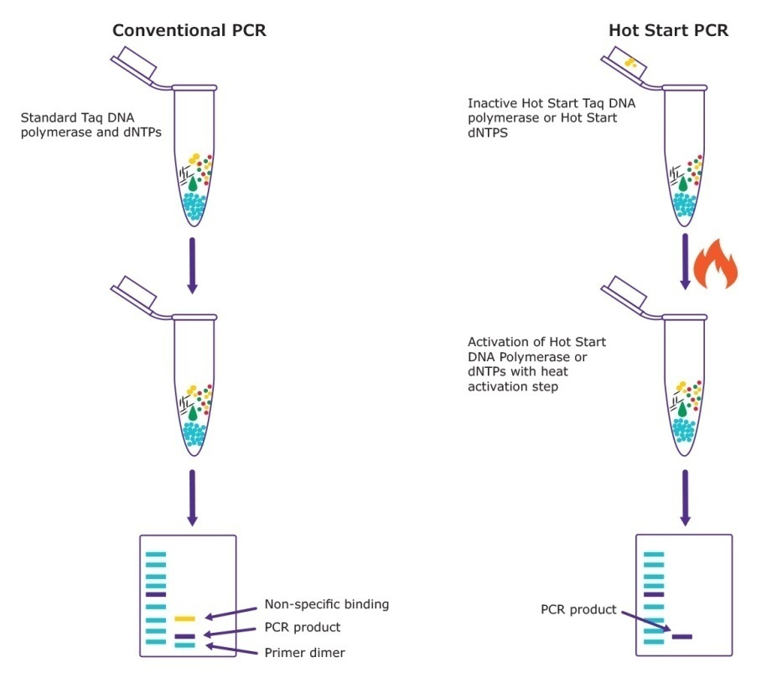
Comparison of conventional and Hot start PCR

Slide 19
Asymmetric PCR
Amplifies one strand of target DNA
Thermocycling with limiting amount or leaving out primer

Slide 20
Touchdown PCR
Annealing temperature is decreased in later cycles
In early cycles 3-5 degree above the standard Tm
Later cycles 3-5 degree below Tm
Initial higher T leads to greater specificity for primer binding
Lower T permit more efficient amplification at the end of reaction

Slide 21
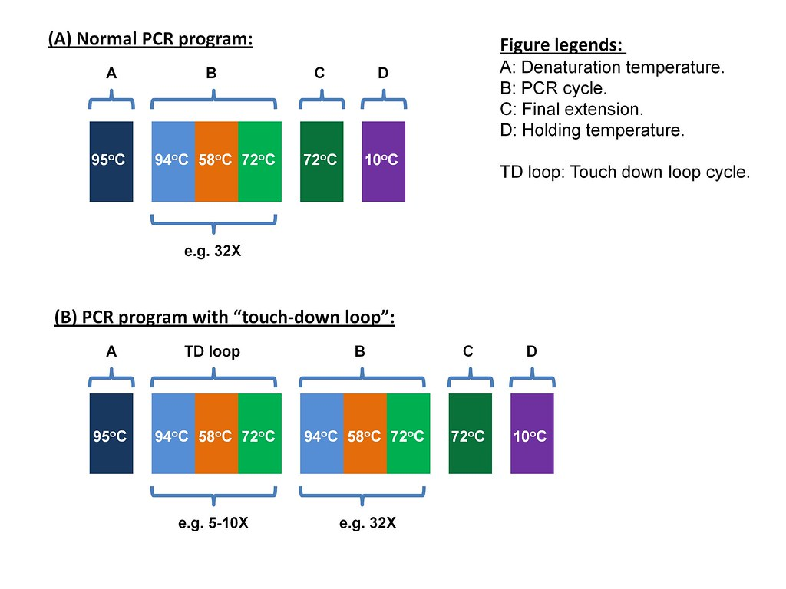
Normal versus Touchdown PCR

Slide 22
Colony PCR
Bacterial colonies are screened directly
Colonies are separated with sterile pipette tip
Cells are transferred into a PCR mix
To release DNA from cells PCR is started either by:
Extended time at 95 degree
Shortened denaturation step at 100 degree
Special chimeric DNA

Slide 23
Colony PCR

Slide 24
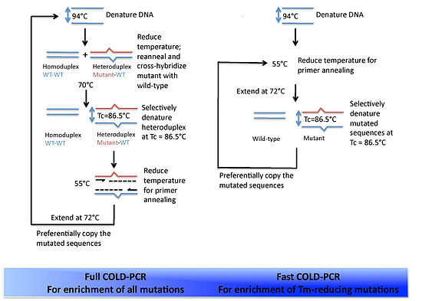
COLD-PCR
It is a modified protocol that enriches variant alleles from a mixture of wildtype and mutation-containing DNA.
Full COLD and Fast COLD PCR

Slide 25
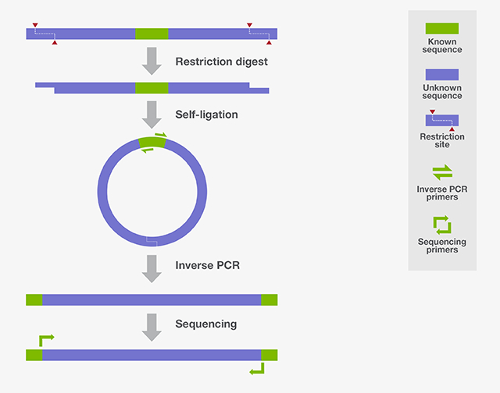
Inverse PCR

Slide 26
Advantages
Simplicity, easier methodology, sensitive, extensively validated standard operating procedure and availability of reagents and equipment.

